Slide 1
Victorian Road Accident Data Visualisation
Parth Parekh

Slide 2
Business Problem
Victorian Government has been facing increased road accident problem and they need to analyse the historic data and help make some policies/initiatives to decrease the accident rate and casualties.

Slide 3
Business Questions
How does speed limit effect accident rate and severity?
How does lighting condition impact the rate of accident?
What does accident region indicate?
Which type of accidents are most common?
Potential solution to decrease the rate of accidents.

Slide 4
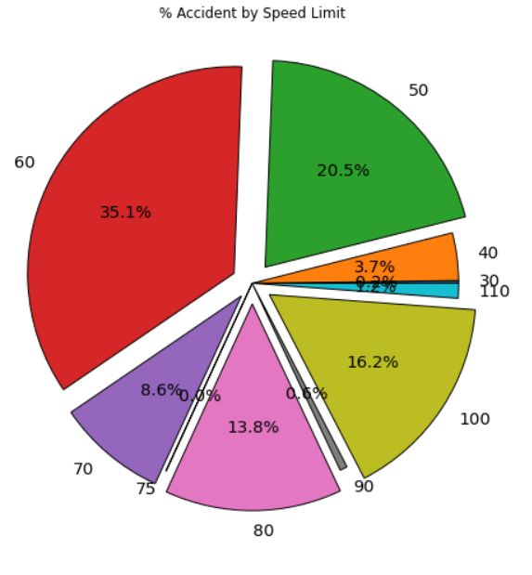
Speed Limit
Evidential from the visuals, the rate of accident increases as the speed limit increases. Almost 70% accidents take place after the speed limit of 60. The casualty also increase as speed limit increases.

Slide 5
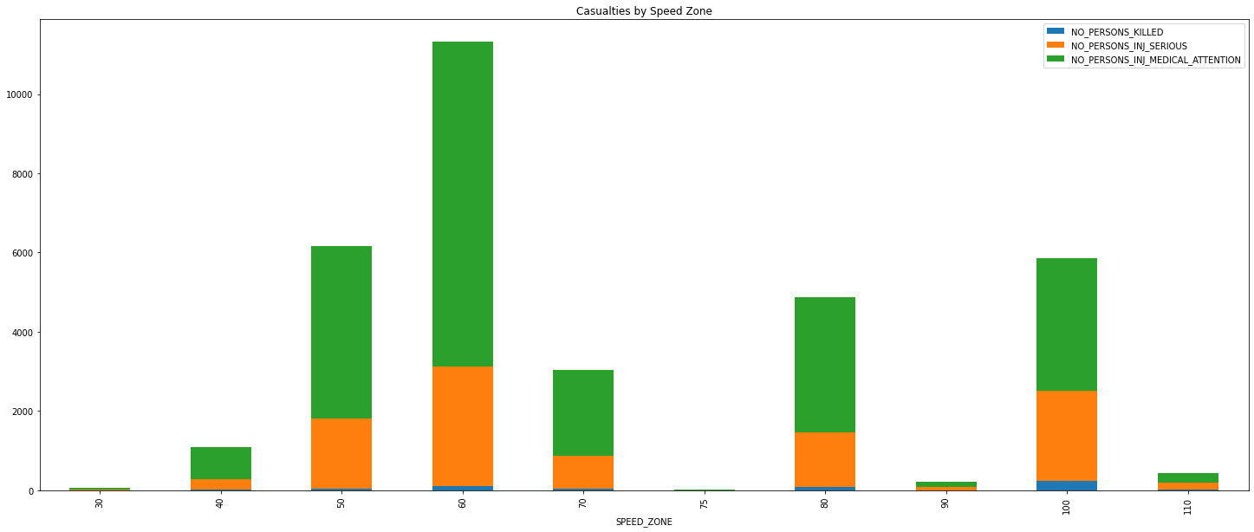
Casualty by Speed Limit

Slide 6
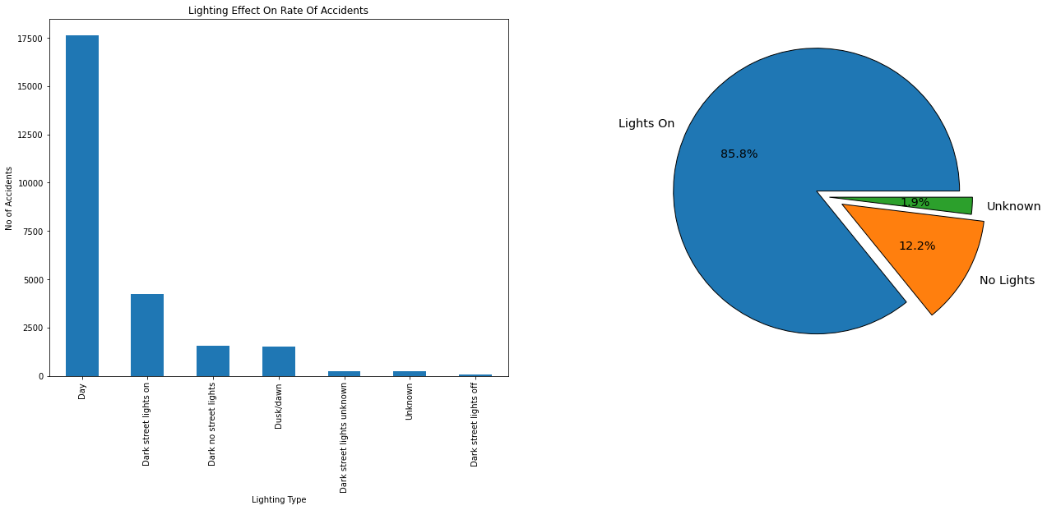
Lighting Condition
From the visuals it is clear that poor lighting or dark lighting condition is not a reason for higher rate of accident. About 86% accidents take place during day time or good lighting condition

Slide 7
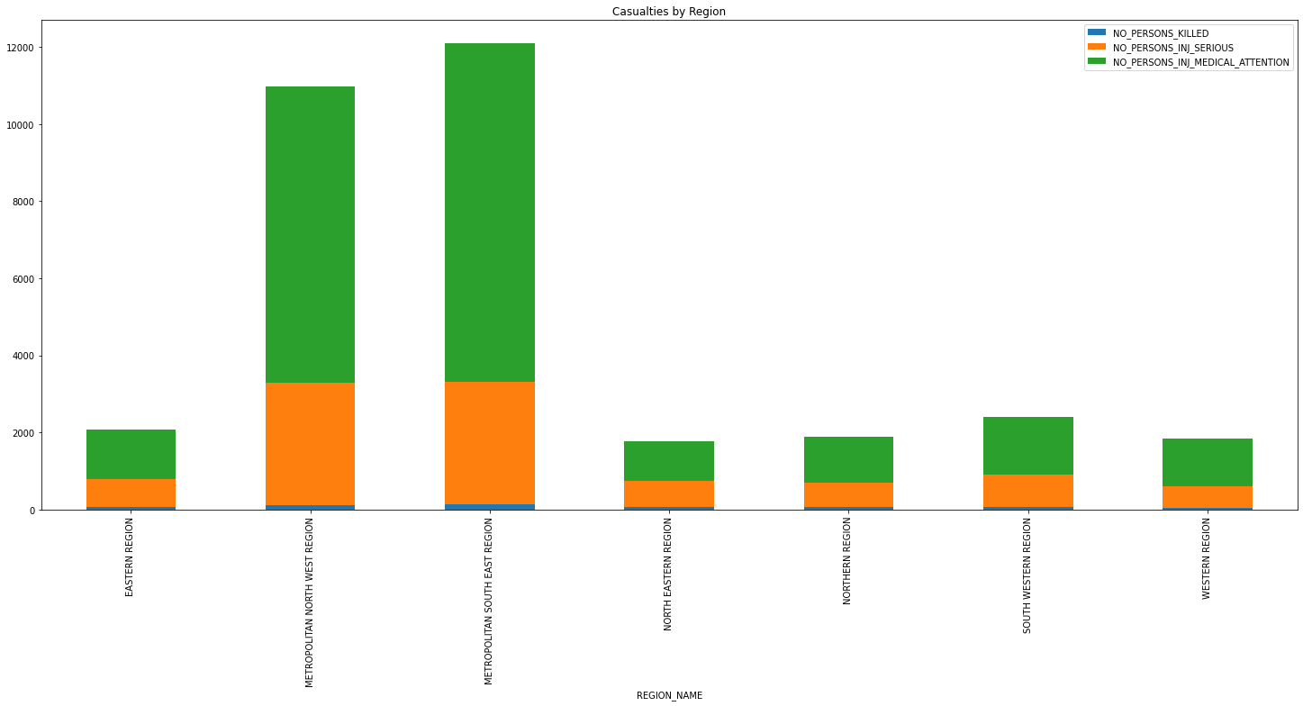
Accident Region
More accidents, casualties and serious injuries can be noticed in the Metropolitan Areas/Build up areas. The Metropolitan areas are well lighted and have lower speed zones still contributes to almost 85% of accidents

Slide 8
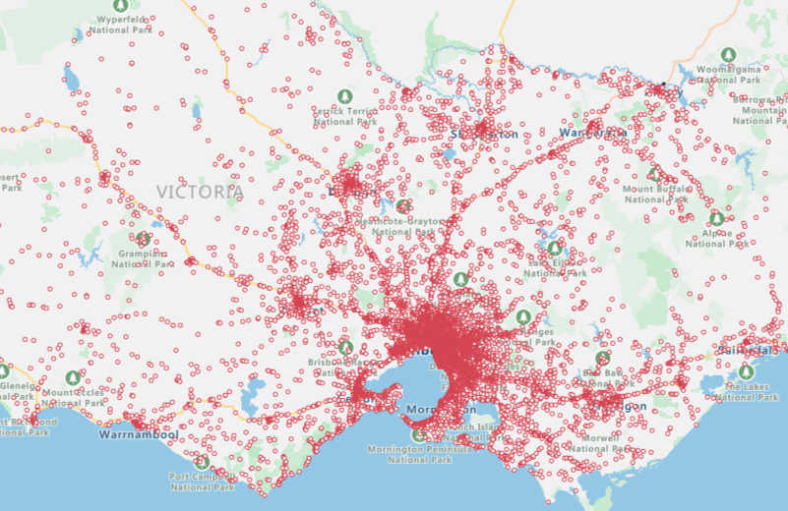
Accident Region

Slide 9
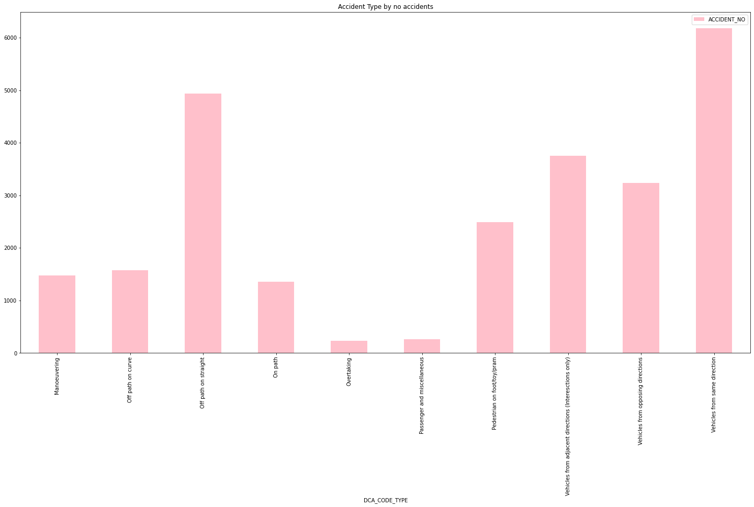
Type of Accidents
As seen from chart most accidents take place with vehicles travelling in same direction or vehicle going off path on straight road. This indicates that most vehicles might be travelling at higher speed or might have miss judged the distance between adjacent cars

Slide 10
Potential Work Around
After analysing a few data points and referring some sources online, here are some of the measure that can be implemented to reduce the rate of accidents and casualties/injuries:
Reduce speed limit to 50 or below in build up metropolitan areas.
Highest accident type is “Vehicle from same direction” with description as “Read End” this indicates the bad visibility due to blind spots. Also, accidents at “T” intersection is due to poor visibility on on-coming traffic. Installing more blind spot mirror on roads and vehicles can reduce the rate of accidents.
Second highest accident type is “Off Path on straight”. Solution here would be to implement ‘Super-elevation’ of roads on the bends to avoid skidding at higher speeds and during turns [1].
To avoid pedestrian casualties something like more reflectors at pedestrian crossing and increase in time of pedestrian signal would be beneficial.

